Slide 1
> glasgowrpg

Slide 2
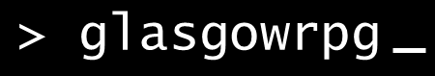
Overview
Text based rpg
Providing a story with multiple branches and outcomes
Based in/around student life.

